Slide 1



Co Learn X
Smart learning platform · project showcase
X
COLEARN
2026
Group: B03
CHENSHIBO WANGFUMING
LIGUONING WANGZEHAO
YANGFENG CHENDAILIN
Notes:
[Sources]
- AI-generated editorial learning-platform image created for this presentation.
[/Sources]

Slide 2
Co Learn X
Individual Contribution Summary
Team Member | Main Functional Responsibilities | Design / Diagrams | Testing / Iteration | Report / Management / Technical Contributions
CHENSHIBO | Learner Function Analysis, User Flow, User Stories | User Flow and Requirement Structure | Internal Review, Evaluation Result Analysis, Multi-user Profile Navigation Research | Main Final Report Writing, Report Material Coordination, Individual Contribution Consolidation, GitHub Folder Organisation
CHENDAILIN | Role System, Publishing Logic | Gantt Chart | First Prototype Evaluation, Internal Group Testing, Functional Retesting | Meeting Minutes, Report Charts and Statistical Analysis, Project Management Documentation
WANGZEHAO | Editor, Draft and Publishing Functions | ER Diagram, High-Fidelity Prototype V2 | First and Second Prototype Evaluations, Functional and User Experience Testing | Evaluation Results and Supporting Materials
LIGUONING | Course, Shopping Cart, Payment and Learning Pages | High-Fidelity Prototype V1, Four Prototype Iterations | UI/UX Improvements, Bug Fixes, Sponsor-Feedback-Based Iteration | Final Group Presentation / PowerPoint, Prototype and Wireframe Materials
YANGFENG | Points System, Refund Logic, Admin Rules | High-Fidelity Prototype V3 | Bug Fixing, Second Prototype Evaluation, Logic Validation | Points / Wallet and Refund Business Rules
WANGFUMING | Admin Pages, System Integration | 21 Use Case Diagrams | Integration and Testing of the 23-Screen Prototype | Technology Stack Selection, Google OAuth Proof of Concept, GitHub Material Management, Technical Integration

Slide 3
PROJECT
TABLE OF CONTENTS
01
05
03
02
04
Project Overview & Technology Stack
Creator & Trainer Publishing Features
Conclusion & References
User Purchase & Learning Experience
Points System, Refund Policy & Admin Management

Slide 4
Co Learn X
PLATFORM OVERVIEW
01
Project Overview & Technology Stack
A unified experience for learners, instructors, and creators—combining courses, progress tracking, and knowledge exchange.

Slide 5

Co Learn X
CoLearnX Learning Platform Overview
CoLearnX is a role-based online learning platform that connects learners, trainers, content creators and administrators in one system.
Four User Roles
Member — Browses, purchases and accesses courses and digital content.
Trainer — Creates and manages online or offline courses.
Creator — Publishes and sells digital learning resources.
Administrator — Reviews role applications, refunds and platform activities.
Core Platform Functions
Course and digital content marketplace
Trainer and Creator publishing tools
Unified point purchase and income system
Learning status and purchase record management
Refund requests and Admin review
Notes:
[Sources]
- AI-generated editorial learning-platform image created for this presentation.
[/Sources]

Slide 6
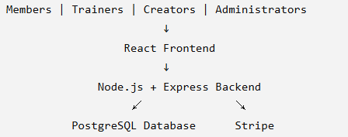
Co Learn X
Frontend: React
Builds interfaces for different user roles
Supports reusable page components
Manages navigation and interactive states
Proposed Technical Architecture
Backend: Node.js and Express
Provides REST APIs
Handles platform business logic
Supports authentication and access control
Database: PostgreSQL
Stores users and roles
Stores courses and digital content
Manages orders, points, learning and refund records
Payment Integration: Stripe
Supports external point top-ups
Provides hosted checkout
Supports payment testing and verification
Notes:
[Sources]
- AI-generated editorial learning-platform image created for this presentation.
[/Sources]

Slide 7
Co Learn X
Why This Technology Stack Fits CoLearnX
React
The team is already familiar with it.
It reduces additional learning time.
It supports reusable and consistent interfaces.
React
Node.js and Express
Node.js and Express
JavaScript can be used for both frontend and backend.
It is suitable for developing web APIs.
It makes communication, maintenance and code review easier.
PostgreSQL
It is suitable for structured and connected data.
It can connect users, courses, orders and point records.
It supports reliable queries and data consistency.
PostgreSQL
Stripe
It provides clear documentation.
It supports secure hosted checkout.
It offers a useful testing and payment verification environment.
Stripe
Notes:
[Sources]
- AI-generated editorial learning-platform image created for this presentation.
[/Sources]

Slide 8
Co Learn X
02
User Purchase & Learning Experience

Slide 9
Co Learn X
User Purchase & Learning Experience
Course Discovery
Browse courses and digital learning content
Explore online and offline options
Compare trainers, prices and schedules
Purchase Decision
Check course duration and delivery format
Review course modules and replay availability
Understand refund conditions before purchasing
Cart and Payment
Add multiple items to the shopping cart
Check point balance and order total
Complete purchases using unified points
Learning Management
Access purchased courses in My Courses
Check course status and watch time
Manage purchase records and refund eligibility
Bottom Summary
neXt connects course discovery, point-based purchasing and learning management in one complete user journey.
Browse Courses and Content
View Course Information
Add to Cart
Complete Point Payment
Access My Courses
Manage Learning Status
Notes:
[Sources]
- AI-generated editorial learning-platform image created for this presentation.
[/Sources]

Slide 10

Co Learn X
How This User Flow Improves the Learning Experience
Clear Purchase Decisions
Course information is displayed before purchase.
Users can check the price, schedule and delivery format.
Trainer and course information support better decisions.
Simple Purchase Process
Multiple items can be added to the shopping cart.
All platform purchases use one unified point system.
Course access is provided automatically after payment.
Flexible Learning Options
Online and offline courses are supported.
Users can choose single sessions or course series.
Replay may be available for selected online courses.
Transparent Learning Management
Users can check course and purchase status.
Learning time and transaction records are stored.
Refund eligibility is clearly displayed.
Notes:
[Sources]
- AI-generated editorial learning-platform image created for this presentation.
[/Sources]

Slide 11
Co Learn X
03
Creator & Trainer Publishing Features

Slide 12
Member
Creator & Trainer Publishing Feature
Apply for Trainer or Creator
Trainer Course Publishing
Create online or offline courses
Set single sessions or course series
Add schedules, duration and modules
Configure replay and course materials
Creator Content Publishing
Create digital learning content
Set content type and point price
Upload files, videos, images or links
Manage and update published content
Role-Based Access
Members cannot publish directly
Users apply for Trainer or Creator roles
Admin approval unlocks publishing tools
Different roles receive different editors
Publishing Management
Save drafts
Validate required information
Publish or update resources
View published items
Admin Reviews the Application
Role Permission Is Approved
Create a Course or Digital Content
Save and Validate the Draft
Publish
Notes:
[Sources]
- AI-generated editorial learning-platform image created for this presentation.
[/Sources]

Slide 13
Co Learn X
Role-Based Access Control
Trainers and Creators receive different permissions.
Unapproved Members cannot access publishing tools.
This reduces the risk of unreviewed content entering the platform.
How the Publishing System Supports Different Roles
Structured Editing Tools
Editors guide users through the required information.
Course and content information is checked before publishing.
This reduces missing prices, schedules or course modules.
Flexible Delivery Formats
Online and offline courses are supported.
Trainers can create single sessions or course series.
External links, live delivery and replay settings are supported.
Complete Publishing Management
Resources can be saved as drafts.
Published items can be updated later.
Trainers and Creators can manage their published resources.

Slide 14
Co Learn X
Points System, Refund Policy & Admin Management
04

Slide 15
Co Learn X
Unified Points and Transaction System
External Payment
Purchase Platform Points
Point Top-Up
Users purchase points through external payment methods.
Cards, PayNow and digital wallets are supported.
Points are added to the platform wallet after payment.
Platform Purchases
Courses and digital content are purchased using points.
Users do not make a separate external payment for every item.
The wallet balance and order total are displayed at checkout.
Income and Transaction Records
Trainers and Creators receive points from sales.
Income may remain frozen until the refund period ends.
The wallet records top-ups, spending, income and refunds.
Points Enter the User Wallet
Purchase Courses or Digital Content
Trainer or Creator Income
Transaction Record
Notes:
[Sources]
- AI-generated editorial learning-platform image created for this presentation.
[/Sources]

Slide 16
Refund Policy & Admin Management
Co Learn X
Refund Policy
Offline course watch time must be under 20%.
Online course refunds must be requested before the required deadline.
The system displays whether the course is eligible.
Users must provide a refund reason.
Refund Review
Admin checks the purchase and course information.
Watch time, course status and eligibility are reviewed.
Approved refunds return points to the user’s wallet.
Rejected refunds keep the original transaction.
Admin Management
Review Trainer and Creator applications
Process user refund requests
Review point and transaction records
Monitor course and content status
User Submits a Refund Request
Check Course Type and Usage
Admin Reviews the Request
Approve / Reject
Return Points
Keep the Transaction
Notes:
[Sources]
- AI-generated editorial learning-platform image created for this presentation.
[/Sources]

Slide 17
Co Learn X
05
Supporting Materials & References

Slide 18
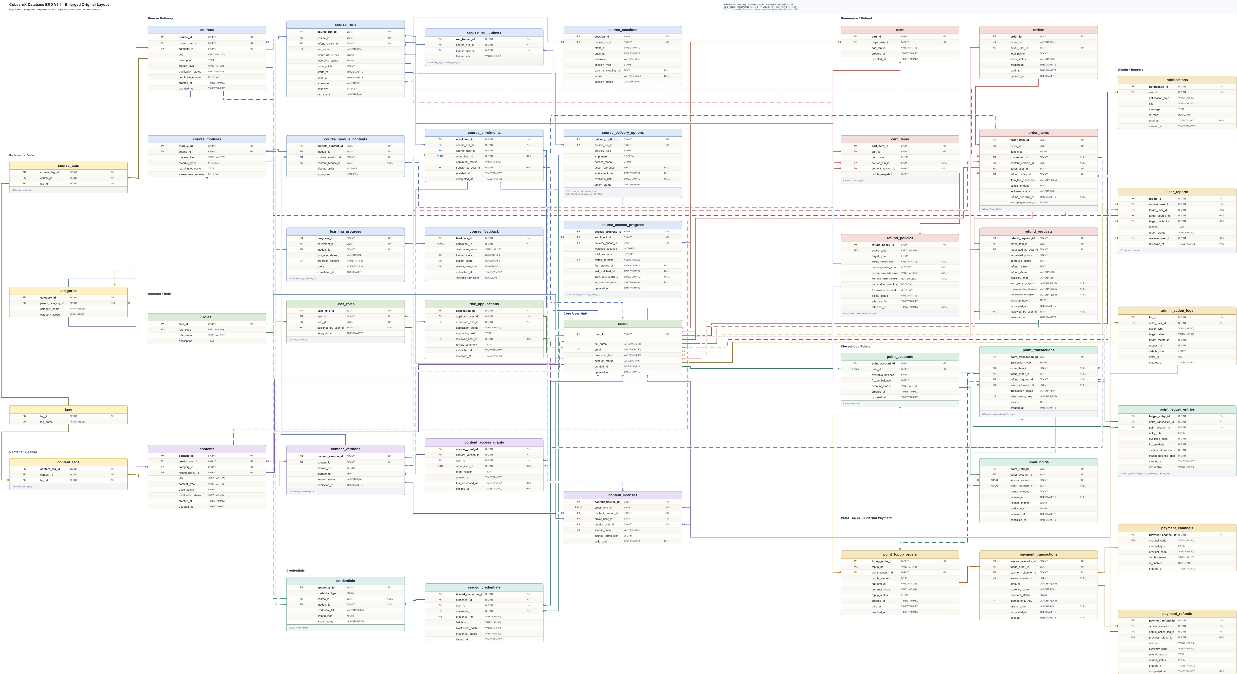
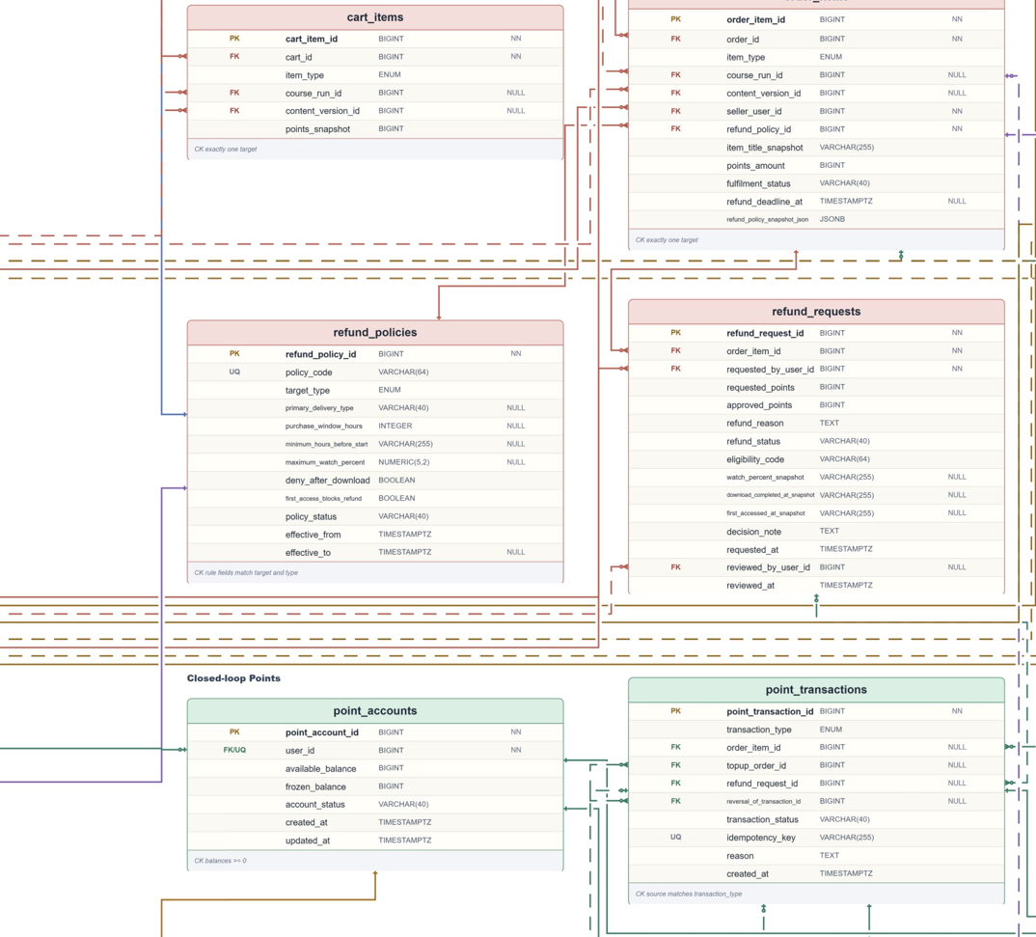
Co Learn X
entity-relationship diagram

Slide 19
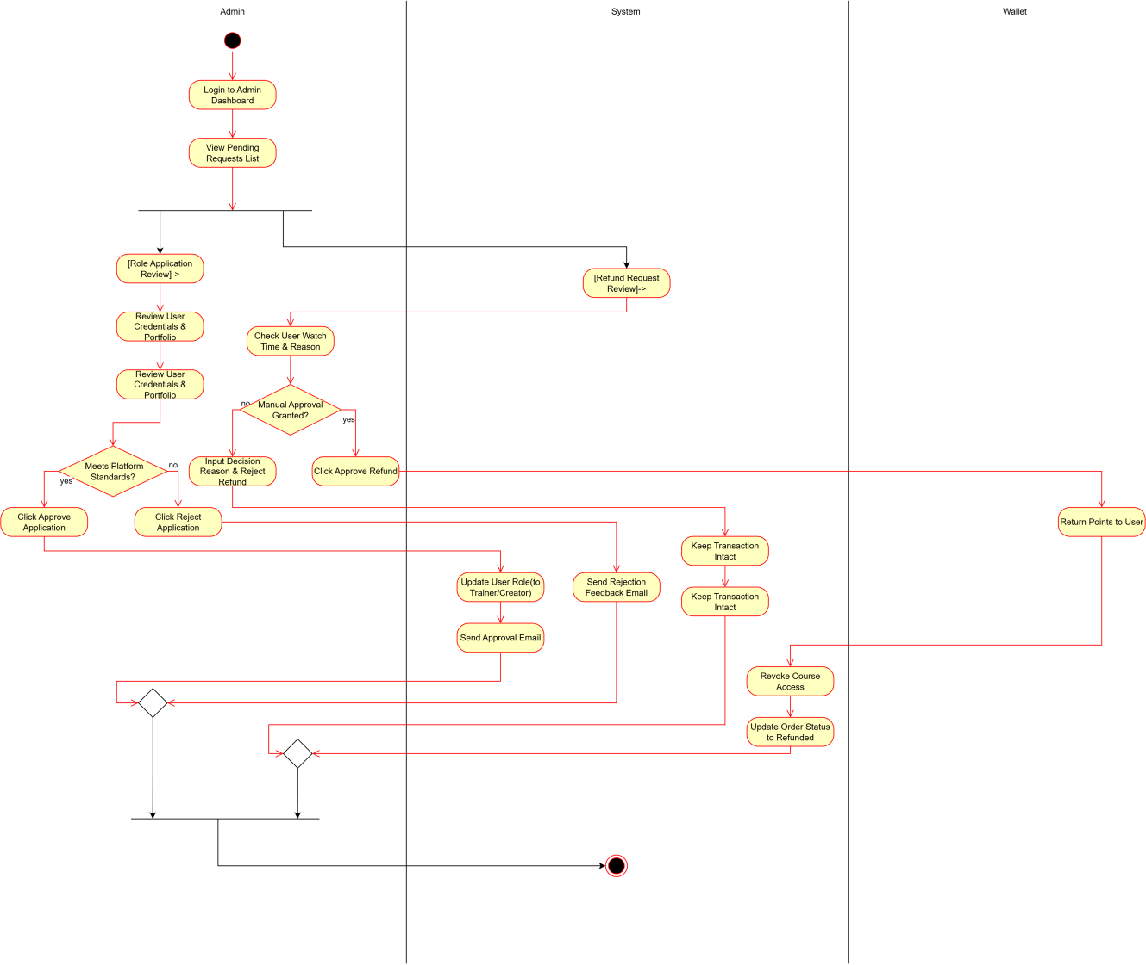
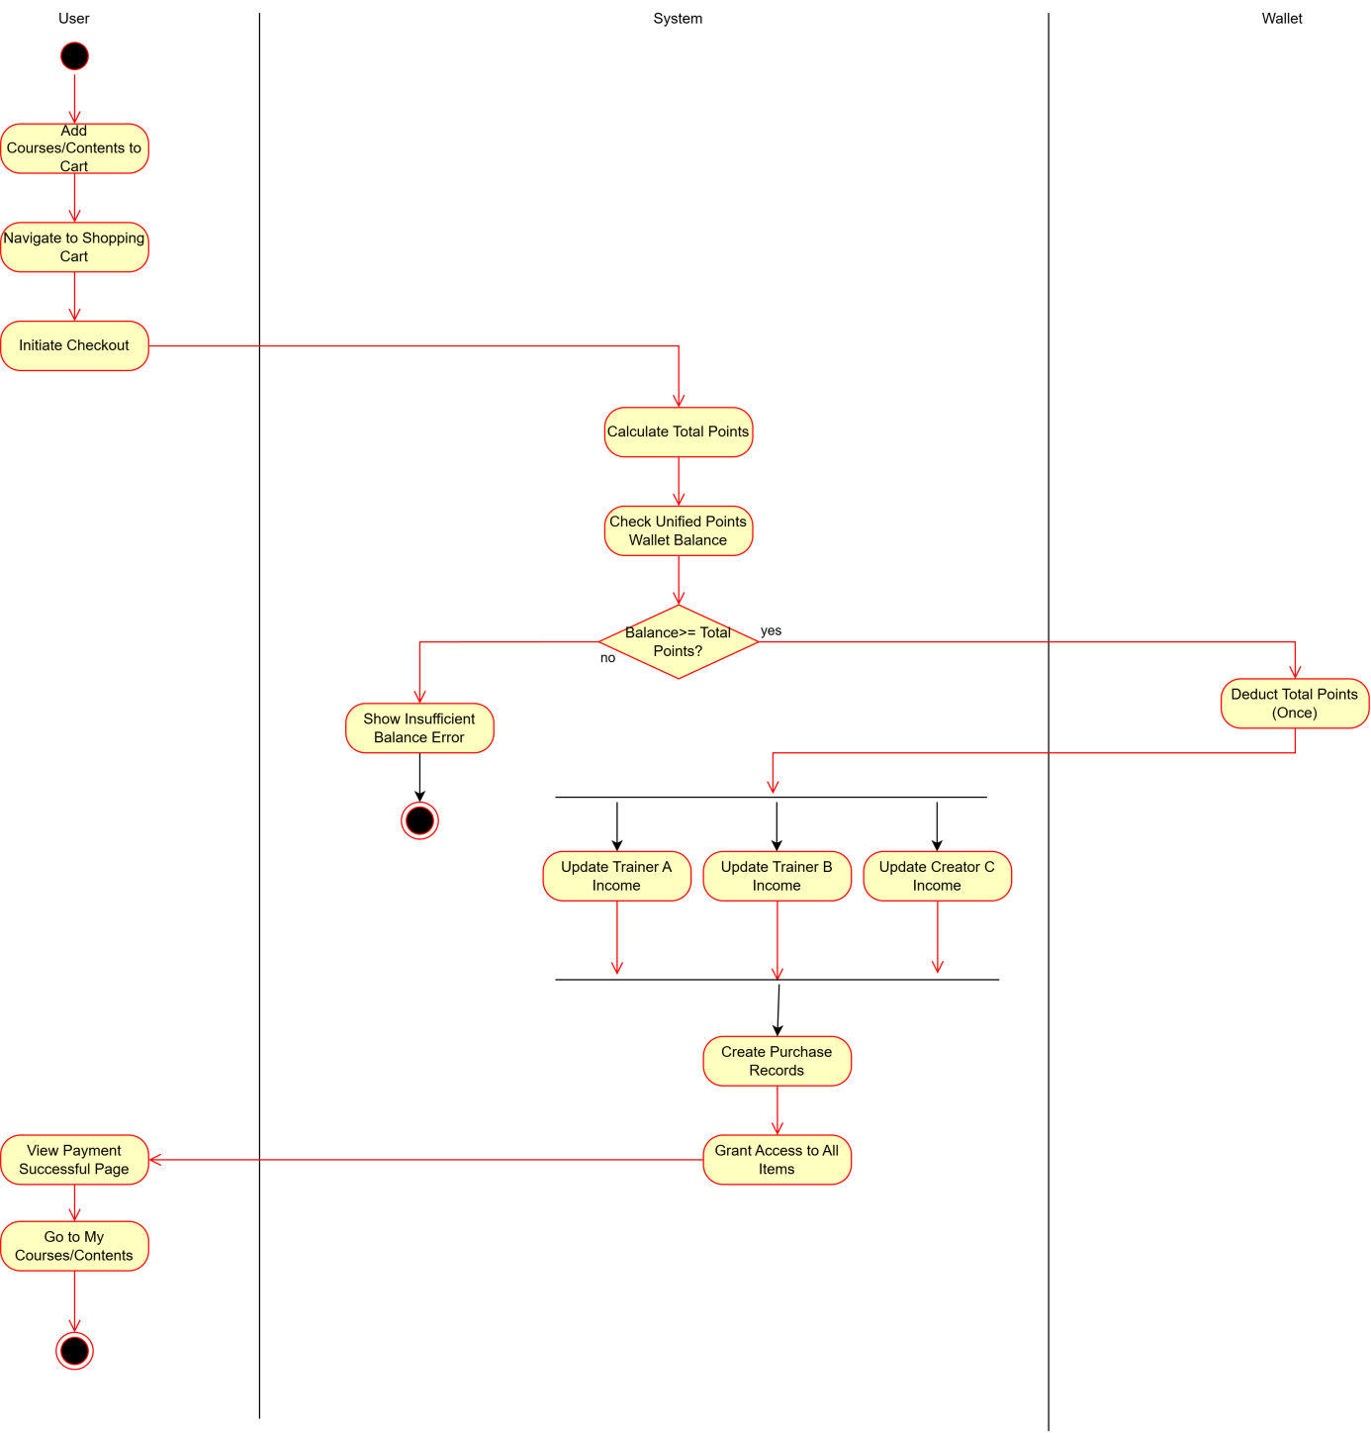
Co Learn X
Activity diagram

Slide 20
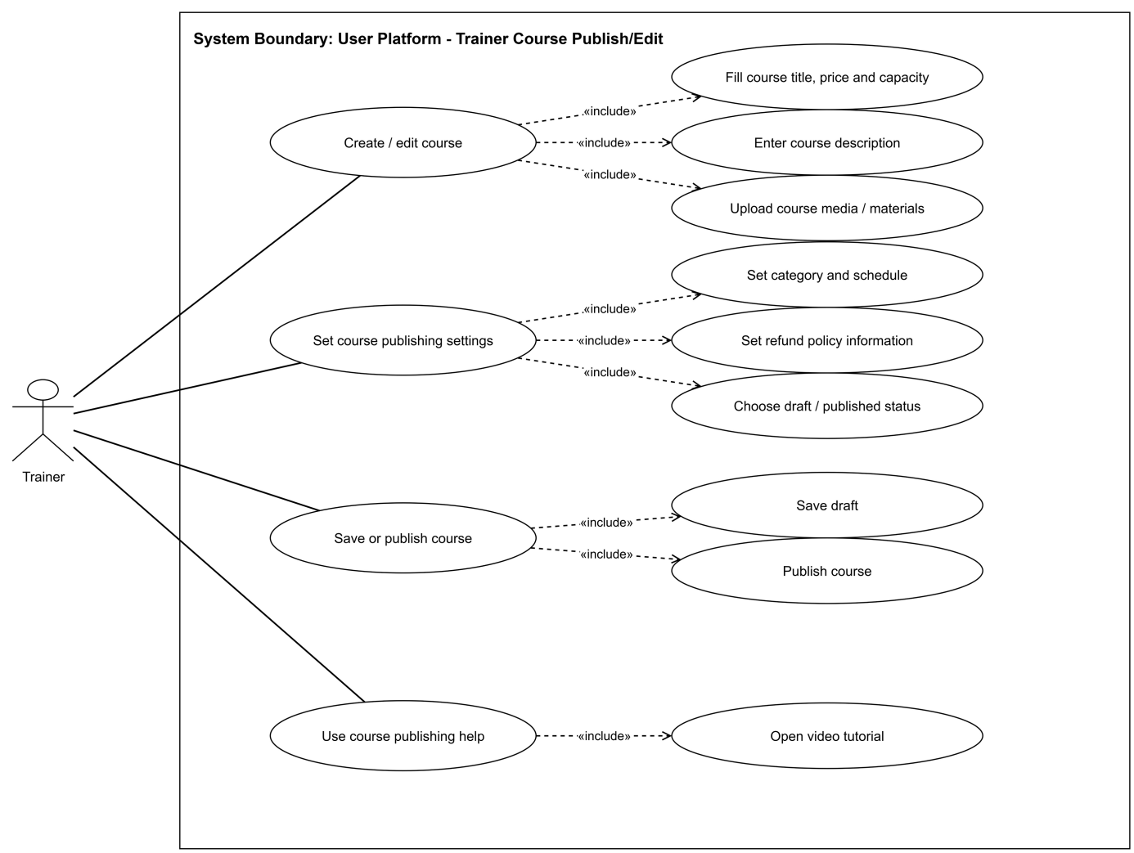
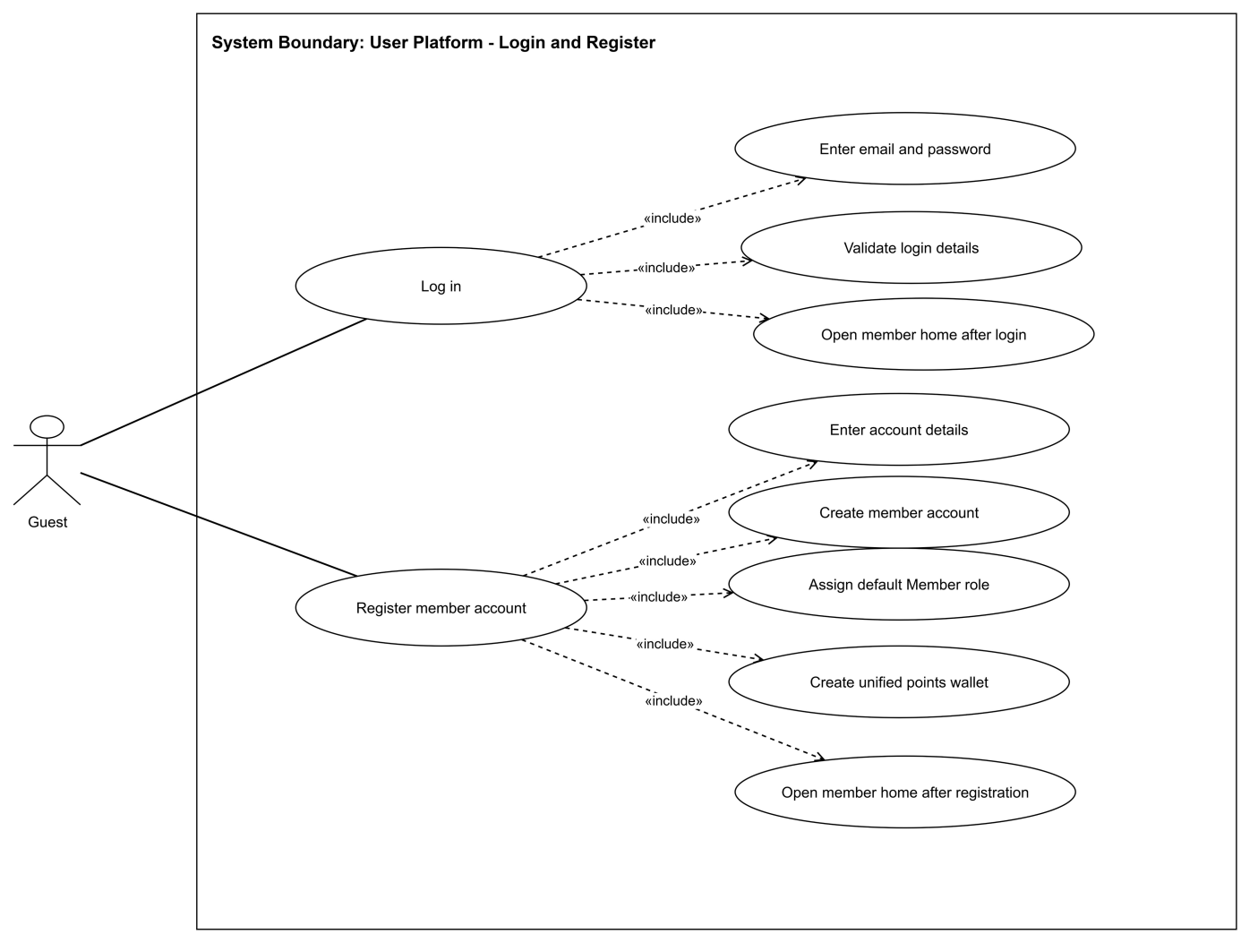
Co Learn X
Usecase diagram

Slide 21
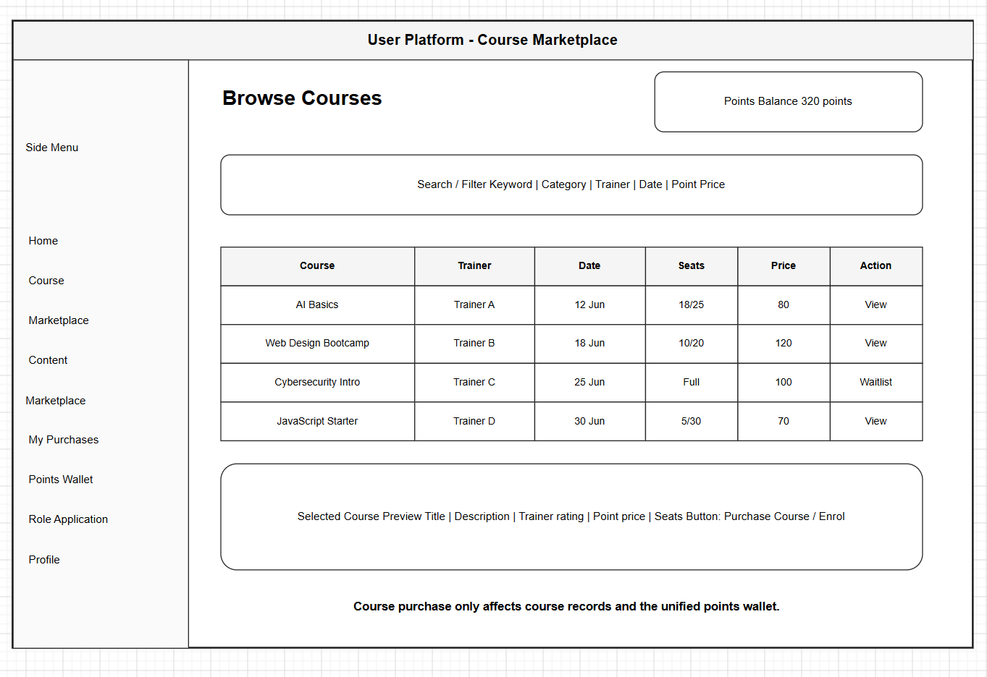
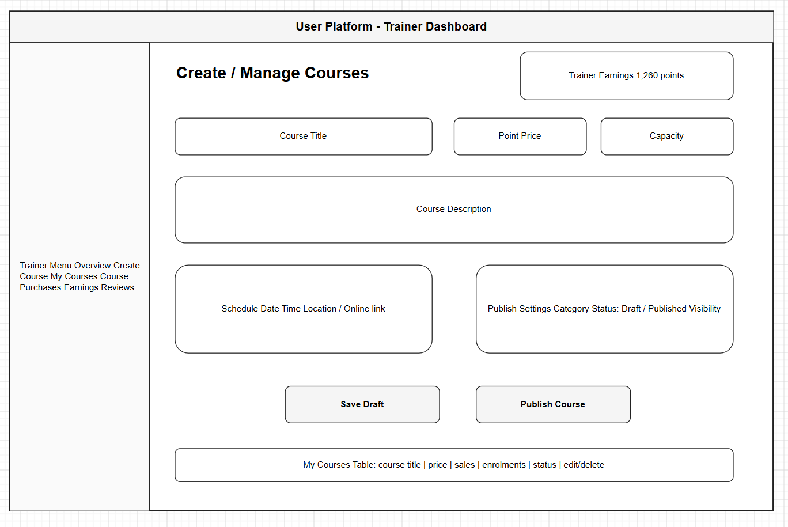
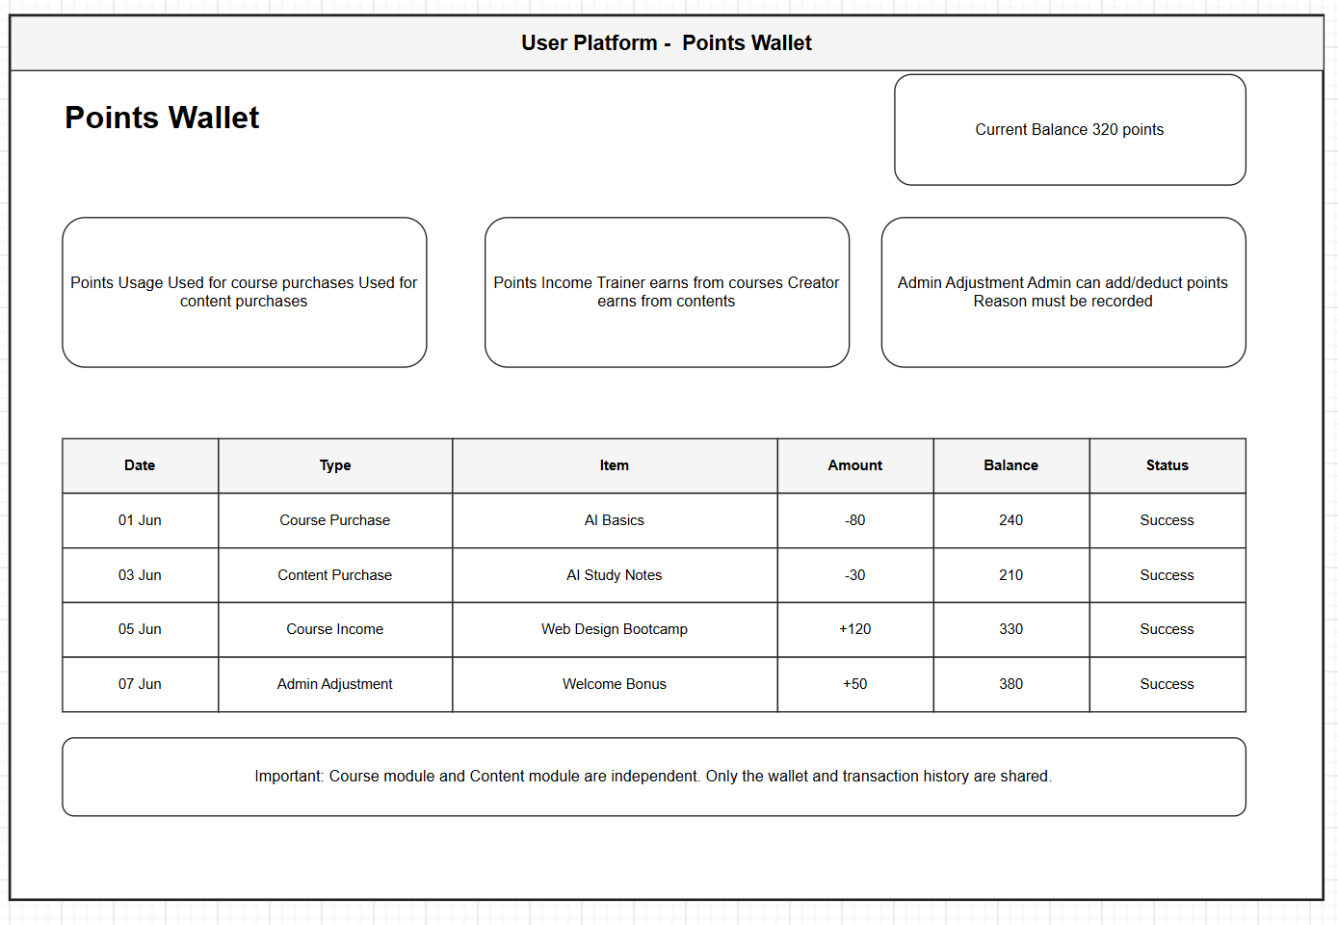
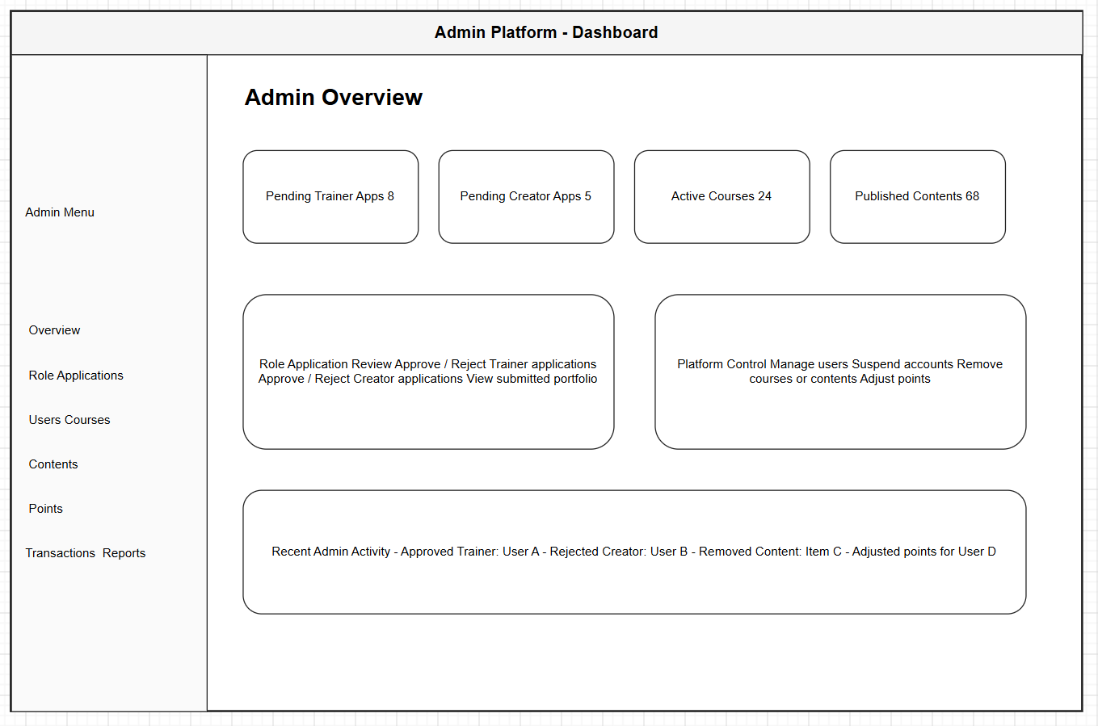
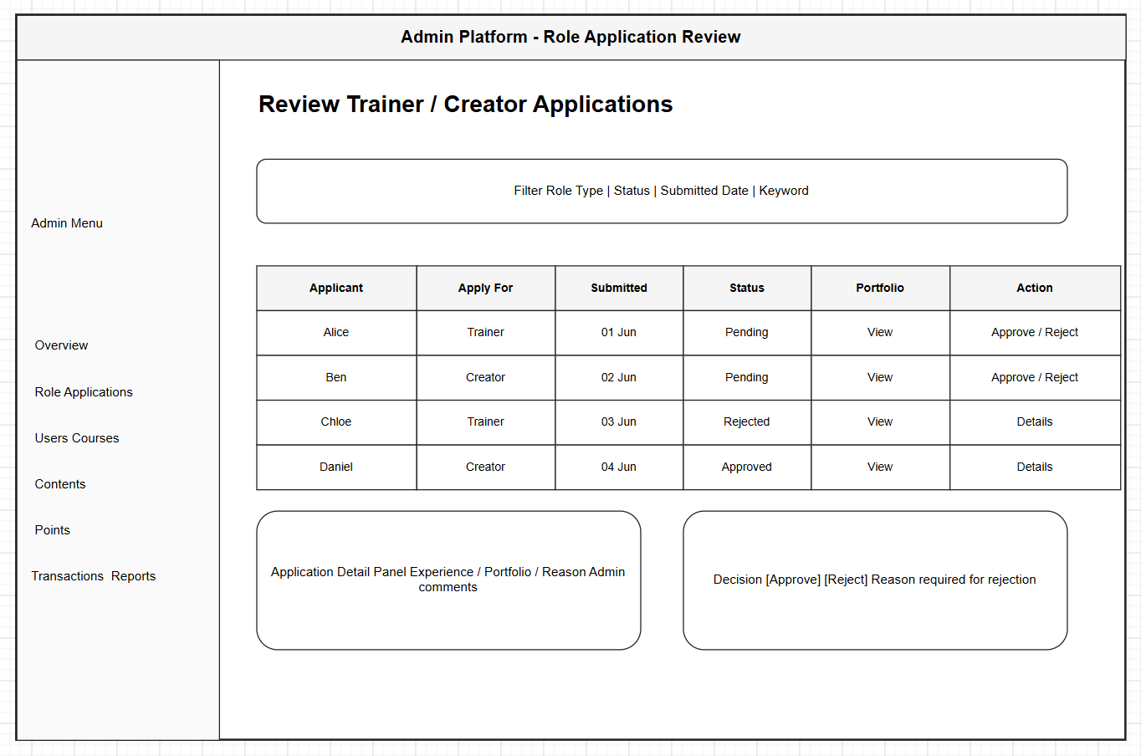
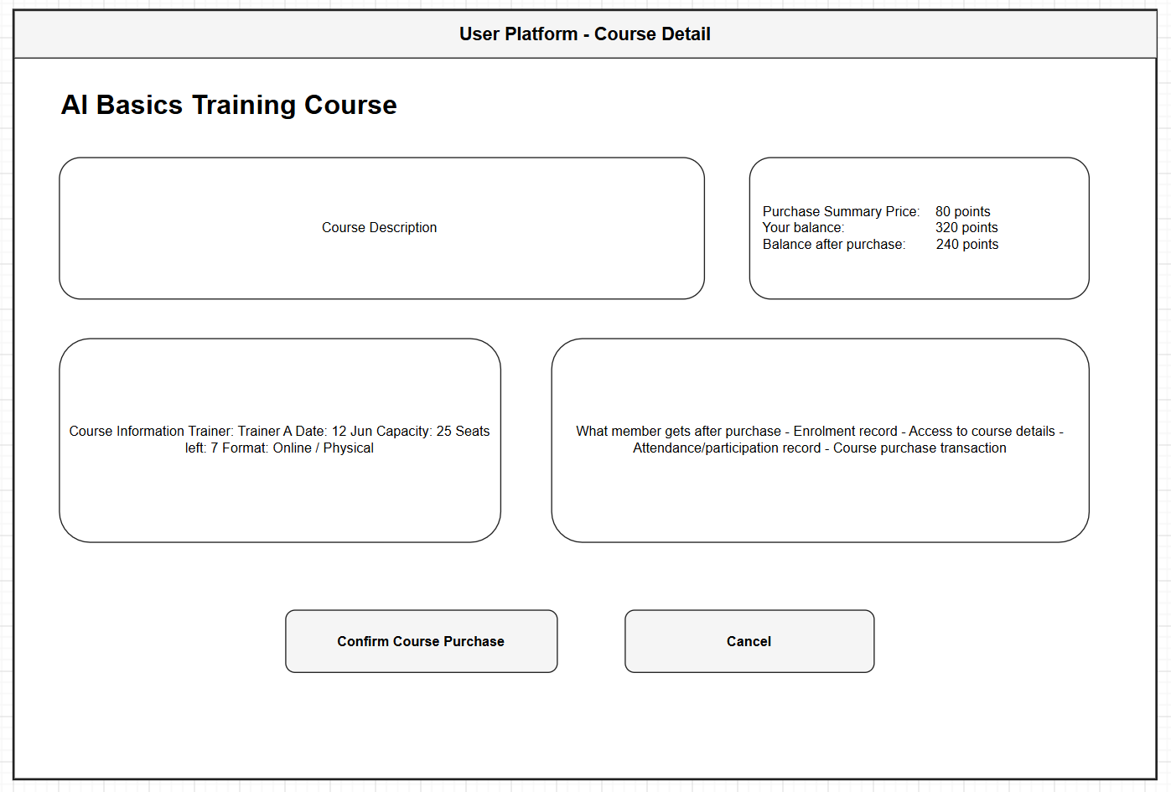
Co Learn X
Prototype

Slide 22
Co Learn X
Admin User Stories
ID
Title
User story
US-A01
Manage user accounts and roles
As an admin, I want to view, edit, suspend or remove user accounts and change their assigned roles, so that I can control platform access and keep the role mix healthy.
US-A02
Review uploaded courses and content
As an admin, I want to review submitted courses and creator content and approve or reject them with a reason, so that only appropriate, copyright-safe items reach the marketplaces.
US-A03
Oversee all training courses
As an admin, I want to view or cancel any trainer’s published course, so that I can correct issues and manage the overall schedule.
US-A04
Adjust member point balances
As an admin, I want to add or deduct points from a user’s wallet with a recorded reason, so that I can resolve disputes and keep the point system fair.
US-A05
Review platform activity reports
As an admin, I want to view participation, sales and usage reports, so that I can analyse platform health and prioritise improvements.
US-A06
Manage categories and tags
As an admin, I want to create, edit, merge or remove categories and tags used by courses and content, so that users can browse the marketplaces consistently.

Slide 23
Co Learn X
References
[1] D.E.W. Technology, “About us,” D.E.W. Technology. [Online]. Available: https://www.dewtech.asia/about-us-2/. [Accessed: 20-Jul-2026].
[2] Google, “Google Classroom — Where teaching and learning come together,” Google for Education. [Online]. Available: https://edu.google.com/workspace-for-education/classroom/. [Accessed: 20-Jul-2026].
[3] Moodle Pty Ltd, “Moodle — Open-source learning platform,” moodle.org. [Online]. Available: https://moodle.org. [Accessed: 20-Jul-2026].
[4] Udemy, Inc., “Instructor revenue share,” Udemy Teaching Center. [Online]. Available: https://support.udemy.com/hc/en-us/articles/229605008. [Accessed: 20-Jul-2026].
[5] GitHub, Inc., “GitHub Docs,” docs.github.com. [Online]. Available: https://docs.github.com. [Accessed: 20-Jul-2026].
[6] Meta Open Source, “React – The library for web and native user interfaces,” react.dev. [Online]. Available: https://react.dev. [Accessed: 20-Jul-2026].
[7] OpenJS Foundation, “Express – Node.js web application framework,” expressjs.com. [Online]. Available: https://expressjs.com. [Accessed: 20-Jul-2026].
[8] The PostgreSQL Global Development Group, “PostgreSQL: Documentation,” postgresql.org. [Online]. Available: https://www.postgresql.org/docs/. [Accessed: 20-Jul-2026].
[9] Stripe, “PCI compliance – Stripe Docs,” stripe.com. [Online]. Available: https://stripe.com/docs/security/guide. [Accessed: 20-Jul-2026].
[10] M. Jones, J. Bradley and N. Sakimura, “JSON Web Token (JWT),” IETF RFC 7519, May 2015. [Online]. Available: https://datatracker.ietf.org/doc/html/rfc7519. [Accessed: 20-Jul-2026].
[11] Personal Data Protection Commission Singapore, “Personal Data Protection Act 2012,” PDPC. [Online]. Available: https://www.pdpc.gov.sg. [Accessed: 20-Jul-2026].
[12] Office of the Australian Information Commissioner, “The Privacy Act 1988,” OAIC. [Online]. Available: https://www.oaic.gov.au/privacy/privacy-legislation. [Accessed: 20-Jul-2026].
[13] OWASP Foundation, “OWASP Top 10:2021,” OWASP. [Online]. Available: https://owasp.org/Top10/. [Accessed: 20-Jul-2026].
[14] J. Nielsen, “10 usability heuristics for user interface design,” Nielsen Norman Group. [Online]. Available: https://www.nngroup.com/articles/ten-usability-heuristics/. [Accessed: 20-Jul-2026].

Slide 24

LEARNING PLATFORM
THANK YOU FOR LISTENING
COLEARNX
2026
Clearer paths, timely feedback, and flexible access help learning continue every day.
Group: B03
CHENSHIBO WANGFUMING
LIGUONING WANGZEHAO
YANGFENG CHENDAILIN
GROW
Notes:
[Sources]
- AI-generated editorial learning-platform image created for this presentation.
[/Sources]

